Slide 1
RUBIX – Notifications
Summary of the Notification Queue process and how communications are sent to the customer

Slide 2
Benefits of the Notification Queue Process
Separates business process from when communications are sent to the customer.
For example, we can have an overnight process, such as invoicing, that will determine whether a customer requires a notification, and the means in which to send it.
The overnight process itself does not send the notification.
A separate notification process will pick up the pending notifications and determine if they should be sent immediately, or during business hours
In this example, the notification process will determine that invoice notifications should be sent during business hours, and wait accordingly
Provides a consistent process for resending a given communication, whether it's Email, SMS, or Mail

Slide 3
How does it work?
The main Object that supports notifications is called Notification_Queue__c (Notification Queue)
This object contains all the necessary information needed to send a message on a given channel. For example, if we're sending an email, it will contain the template to use, the email to send to and when to send the email
The timing of when to send the message is determined by the notification queue record's Send Time field.
Immediate: Send right away
Business Hours: Send during the business hours. The Business Hours Name field will identify which Salesforce Business Hours setting is being adhered to.
Send Next: Send on the next notification batch process, runs every 30 min
Custom: Send at the specified time
External Process: Let another system be responsible for sending the message. Currently this is used by Conga Batch. We use the conga batch schedule to generate documents at certain intervals throughout the day.

Slide 4
Resend an Email or SMS Notification
To resend a notification change the status to Scheduled
If the Send Time is set to Immediate, the process will attempt to send the notification immediately.
If Send Time is set to Business Hours, Next Send or Custom, then the automated process (runs every 30 min) will pick up he record and determine whether it should be sent at that time.

Slide 5
Recreate Conga Document/PDF (Type = Mail)
To re-run the creation of a Conga Document/PDF when the Type is set to Mail, change the Status to Scheduled
The system will immediately create the document using either conga composer or trigger, depending on whether you have a composer license or not
NOTE: In these situations, when Type is equal to Mail, the Send Time is set to Immediate, that is why the document gets created right away.

Slide 6
Recreate Conga Batch Document/PDF (Type = Batch Mail)
To re-run the creation of a Conga Document/PDF when the Type is set to Batch Mail, change the Status to Scheduled
The corresponding Conga Batch job will pick up the record when it runs, and will attempt to create the pdf again

Slide 7
Mailing PDF to Customers End to End Process
When a Rubix related document is generated via Conga, it will initially land in the Mailouts Library (Files > Libraries > Mailouts)
When the file lands in this folder, the system will use the ID in the file name to:
Create a task and associate it with the corresponding record
The task will contain a link to the PDF document
Have it's status set to In Progress
Find the corresponding notification queue record, and change it's status to completed
From an end user perspective, they will see a task associated with the record that initiated the document being generated, and within that task there will be a link to the document

Slide 8
Mailing PDF to Customers End to End Process Cont'd
In the evening, OIC will pick up all documents in the Mailouts folder and move them to Oracle Storage
Once OIC successfully places them in Oracle Storage, it will send a URL of the new location back to Salesforce
Salesforce will then delete the document that's sitting in the Mailouts folder, and update the corresponding task with the URL received by OIC
When a user looks at the task again, they'll see that the url changed, and now points to the document sitting in Oracle Storage

Slide 9
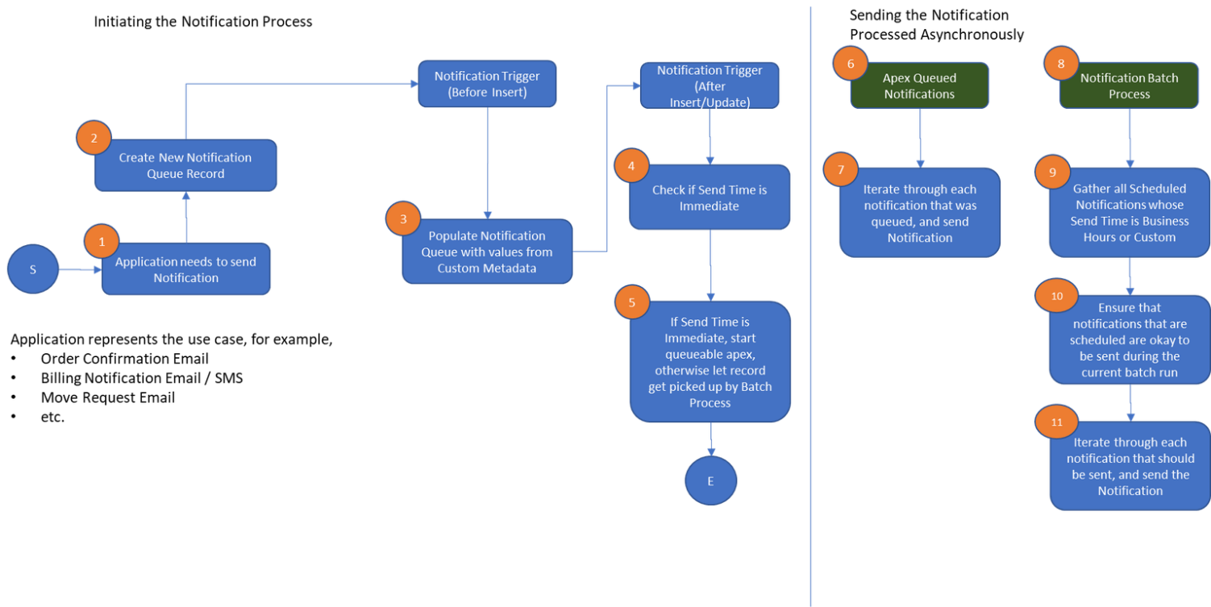
More Information
https://atcocorporatedigital.atlassian.net/wiki/spaces/PRCR/pages/2343141379/RUBIX+-+Notification+Queue+Documentation

Slide 10
Settings – Key / Value custom settings
ER_NotificationQueue_Email_Enabled: Used to control whether emails will be sent via the Notification Queue service. This setting serves as a master switch to enable / disable email delivery. Set to true or false accordingly
ER_NotificationQueue_SMS_Enabled: Used to control whether text messages (SMS) will be sent via the Notification Queue service. This setting serves as a master switch to enable / disable text messages. Set to true or false accordingly.
ER_NotificationQueue_RetentionPeriod - Number of days that must pass before the notification clean up process deletes the notification queue record
ER_NotificationQueue_EmailDeleteRange – Maximum number of seconds the notification clean up process will use when attempting to associate a notification queue record and an email message. More information in the clean up section
ER_NotificationQueue_EmailLimit – Represents a overall percentage of how low the SingleEmail Salesforce limit will get before the Notification Queue stops sending emails. Default is 15, which means the notification queue service will stop sending emails if the overall daily limit drops to 15% or less remaining
ER_NotificationQueue_LimitURL - relative URL used to retrieve information on the Single Email delivery limits on the org. This URL is used to retrieve the current usage and overall limit that is in place
ER_NotificationQueueBatchRecordLimit – Limits the number of pending notification queue records that will be processed in a given batch run. The notification process runs every 30 minutes and will retrieve the maximum number of records specified in this setting.

Slide 11
Custom Metadata - Notification Queue Setting
The Notification Queue Setting custom metadata is used to set up pre-configured notifications that can be easily changed on the fly, without any coding changes.
For example, the residential order confirmation email setting is preconfigured with:
the email template that should be used,
The org-wide email address to use
Attachments that should be included.
There are many settings that can be pre-configured for a given notification, see the next slide for email and sms specific settings.

Slide 12
Custom Metadata - Notification Queue Setting
Common settings used for across notification types
Type: Indicates the type of notification that the overall notification setting represents, possible values are Email, SMS, Mail, Batch Mail
Custom Send Time:
Results Class Name
Send Time

Slide 13
Custom Metadata - Notification Queue Setting
Email based settings
Attachment FileNames – semi-colon (;) delimited string listing the file names of any attachments that should be included in an email.
Attachment URLs – semi-colon (;) delimited string listing the url of any attachments that should retrieved, using the url, and attached in an email.
BCC Email Addresses - semi-colon (;) delimited string listing any email addresses that should be BCC'd on the email sent.
CC Email Addresses - semi-colon (;) delimited string listing any email addresses that should be CC'd on the email sent.
Email Subject – Subject to be used on emails of the given type that are sent out
Org-Wide Address Name - Name of the org-wide email address that should be used when sending the email (i.e. ATCOenergy Collections)
Reply To Email Address - email address that will be designated as the "Reply To" email address sent with a given email
Template API Name - Name of the email template that should be used when building and sending the email
SMS based settings
SMS Messaging Channel Name – name of messaging channel to use when sending a text message. This can be retrieved from Setup > Messaging Settings, and click on the channel that should be used for sending messages of a given type. The value can be pulled from the Developer Name field on the channel (i.e. Text_CA_698956)
Template API Name – Name of Messaging template that would be used to generate and send the message

Slide 14
Custom Metadata - Credit Collections Event Setting
The Credit_Collections_Event_Template__mdt custom metadata acts as a mapping between a credit and collection event and the notification queue custom metadata setting that should be used to send a notification via email or mail.
For example, a PDN (Pending De-Enrollment) event is configured to use the Energy_Credit_Collection_PDN_Email_BH custom setting when sending out a PDN email notification to a customer.
In the event new credit and collection events arise, that require customer notifications, add a record to this custom metadata, mapping it's credit and collection event to the notification templates that should be used to send a notification.

Slide 15
Clean up Process
To avoid the accumulation of Notification Queue records, a process runs daily at 1:45 am MT that will delete applicable notification queue records.
The batch process will start off by retrieving all completed records with a Completed_Date_Time__c older than the number of days specified in the ER_NotificationQueue_RetentionPeriod custom setting.
All completed SMS, Mail and Batch Mail records will be deleted immediately
All completed Email records will go through a secondary verification to ensure that the related record does indeed have an email message that is not marked as bounced.
This ensures that we do not delete notifications that ultimately ended in a bounced email.

Slide 16
Additional Information
RUBIX - Notification Queue Documentation - Project RUBIX (CIS Replacement) - Confluence (atlassian.net)

Slide 17
Common Issues
Email delivery errors
Workflow fails to send email
SMS delivery errors

Slide 18
Common Issues
Need to cancel notifications from getting sent
In the event we need to prevent certain notifications from going out to the customer, you can run a query that identifies all the applicable notifications, and either update them as completed, or delete them altogether
For example, running the following query will identify all Email and SMS invoice notifications that are schedule to be processed.
SELECT ID FROM Notification_Queue__c WHERE Setting_Name__c IN ('Energy_Bill_Notification_Email_BH', 'Energy_Bill_Notification_SMS_BH') AND Status__c = 'Scheduled'
You can then use the IDs to delete the records, or update their status to something other than Scheduled so that they no longer get picked up by the batch process

